Slide 1
Semiconductor Diode Applications

Slide 2
Clippers
Electronic devices are very sensitive to voltage.
An over-voltage can permanently destroy the electronic devices.
To protect electronic devices, clipper circuits can be used.
Clipping circuit:
A wave shaping circuit which controls the shape of the output waveform by removing or clipping a portion of the applied wave.
Half wave rectifier is the simplest example. (It clips negative or positive half cycle).
Also referred as voltage limiters/ amplitude selectors/ slicers.

Slide 3
Clippers
Applications:-
In radio receivers for communication circuits.
In radars, digital computers and other electronic systems.
Generation for different waveforms such as trapezoidal, or square waves.
They are used as noise limiters in FM transmitter

Slide 4
Clippers
There are 4 types of clipper circuits
Positive clipper circuits
Negative clipper circuits
Biased clipper circuits
Combinational clipper circuits

Slide 5
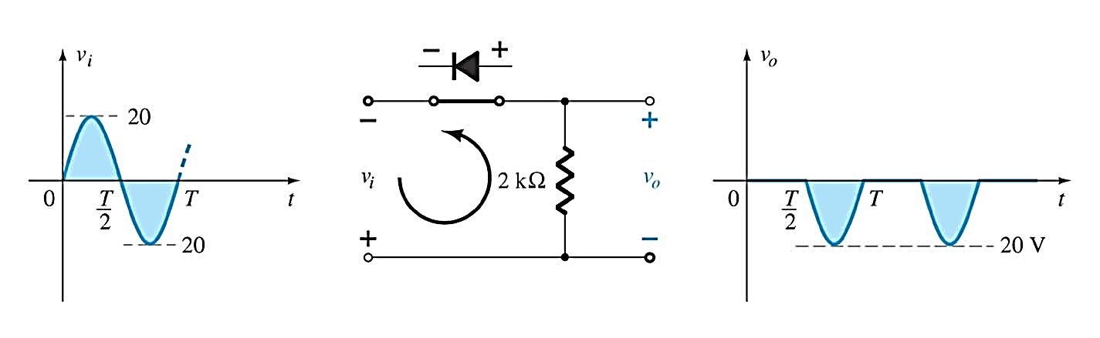
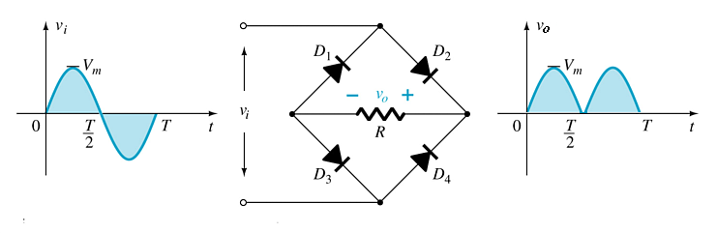
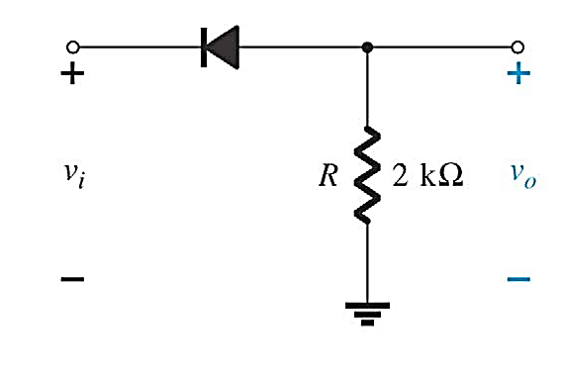
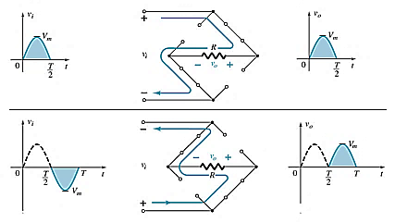
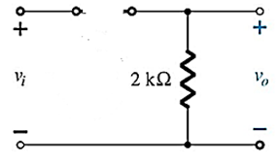
Positive clipper circuits (Series Diode)
In positive clipper, the positive half cycles of the input AC signal is removed.
V_{m}
For positive half cycle
For negative half cycle

Slide 6
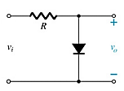
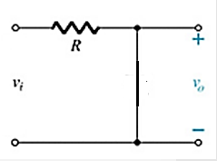
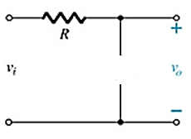
Positive clipper circuits (Parallel Diode)
In positive clipper, the positive half cycles of the input AC signal is removed.
V_{m}
For positive half cycle
For negative half cycle

Slide 7
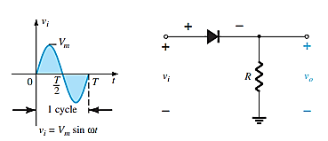
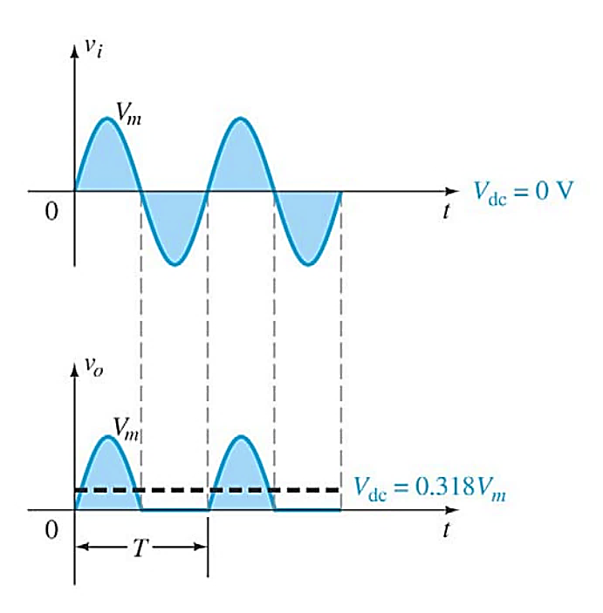
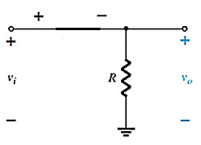
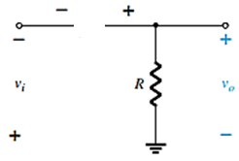
Negative clipper circuits (Series Diode)
In negative clipper, the negative half cycles of the input AC signal is removed.
For positive half cycle
For negative half cycle

Slide 8
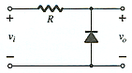
Negative clipper circuits (Parallel Diode)
For positive half cycle
For negative half cycle

Slide 9
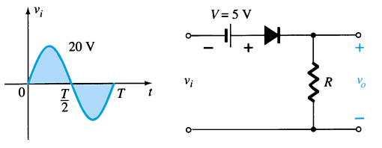
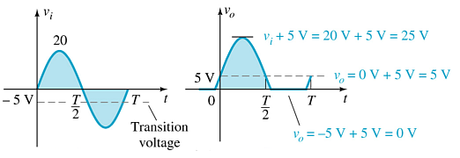




Biased clipper circuits
Adding a DC source in series with the clipping diode changes the effective forward bias of the diode.
First Consider, when diode is forward bias
For positive half cycle,
$$v_{i}=0V, V_{o}=5V$$
$$v_{i}>0, V_{o}=v_{i}+5V$$
For negative half cycle,
$$v_{i}<5V, V_{o}=v_{i}+5V$$
$$v_{i}>5V, V_{o}=0V$$

Slide 10
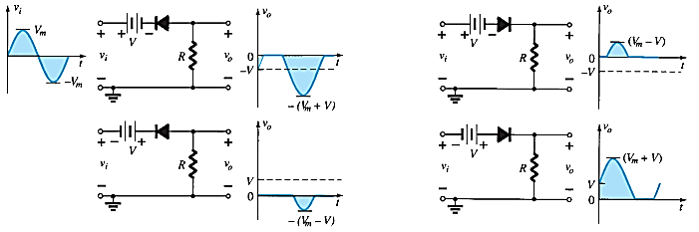
Summary of Clipper Circuits

Slide 11
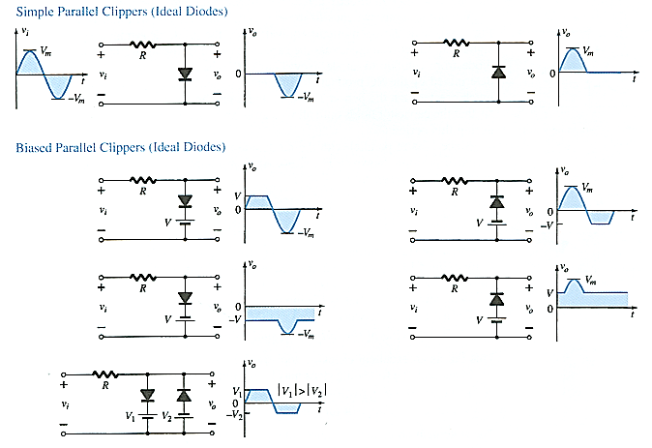
Summary of Clipper Circuits

Slide 12
Clamper Circuits
A circuit that shifts a waveform to a different dc level without changing the appearance of the applied signal.
Note:
Start the analysis of clamping network, by considering that part of the input signal that will forward bias the diode.
During the period that the diode is in the “ON” state, assume that capacitor will charge up instantaneously to a voltage level determined by the network.
Assume that during the period when the diode is in “OFF” state, capacitor will hold on its established voltage level.
Keep in mind the general rule, that
Total swing of total output = Swing of input signal

Slide 13
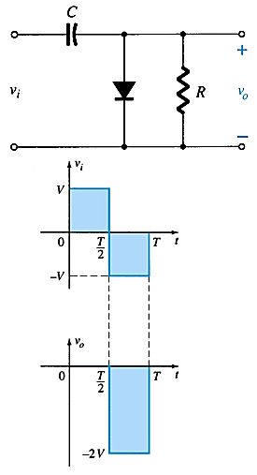
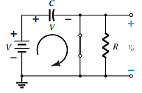
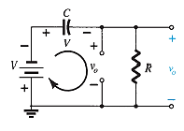
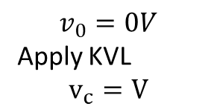
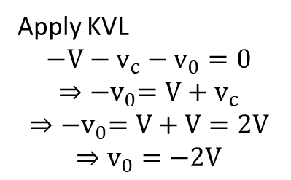
Clamper Circuits
Step 1: Consider the cycle that will forward bias the diode.
$$v_{0}=0V$$
Apply KVL
$$v_{c}=V$$
Step 2: Assume that during the period when the diode is in the “off” state
Apply KVL
$$−V−v_{c}−v_{0}=0$$
$$⇒{−v}_{0}=V+v_{c}$$
$$⇒{−v}_{0}=V+V=2V$$
$$⇒v_{0}=−2V$$

Slide 14
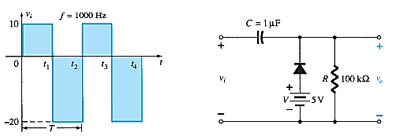
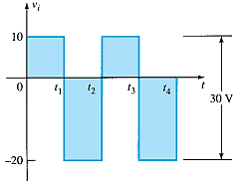
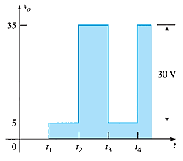
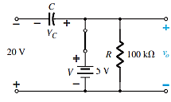
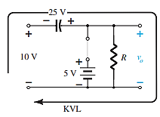
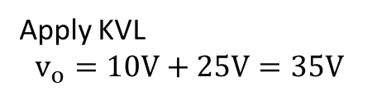
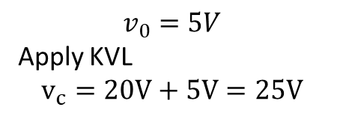
Biased Clamper Circuits
The input signal can be any type of waveform such as sine, square, and triangle waves.
The DC source lets you adjust the DC camping level.
Step 1: Diode is on for negative cycle
Step 2: Diode is off for positive cycle
$$v_{0}=5V$$
Apply KVL
$$v_{c}=20V+5V=25V$$
Apply KVL
$$v_{o}=10V+25V=35V$$

Slide 15
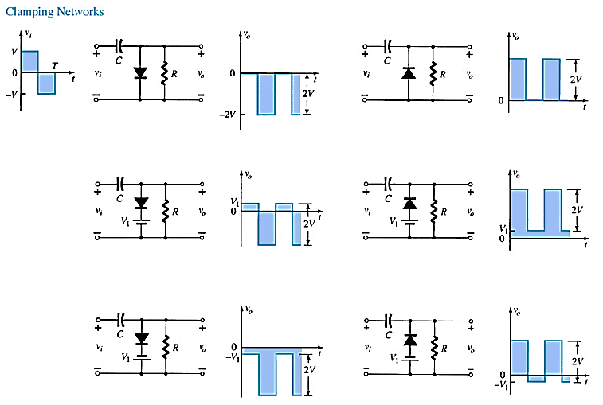
Summary of Clamper Circuits

Slide 16
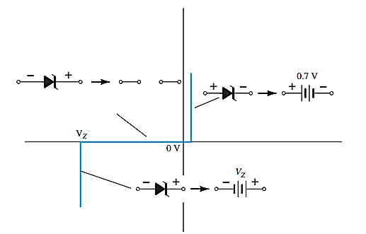
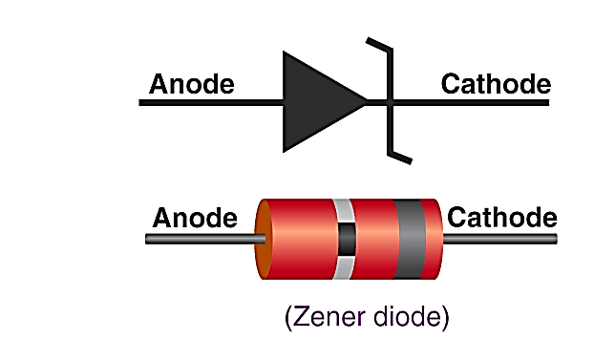
Zener Diodes
A Zener diode is a heavily doped semiconductor diode which is designed to conduct current in the breakdown region.
Voltage regulation is the most common application of a Zener diode.
A voltage regulator circuit keeps the load voltage constant irrespective changes in input voltage or load resistance.
Symbol of Zener diode
Approximate equivalent circuits for the Zener diode in the three possible regions of application.

Slide 17
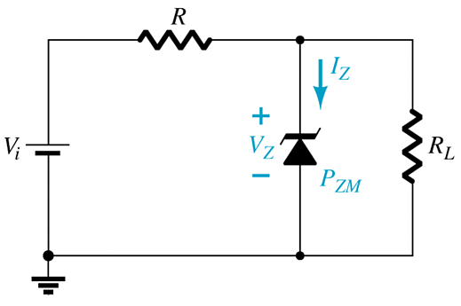
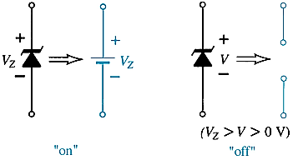
Zener Diodes
Points to be noted:
In forward bias, it acts as a normal PN junction diode.
In reverse bias, it conducts current when the voltage across it is equal to or greater than Zener voltage (V_{z}).
It regulates the voltage across it which is equal to the Zener voltage.
When V_{i} ≥ V_{Z}
The Zener is on
Voltage across the Zener is V_{Z}
Zener current: I_{Z} = I_{R} – I_{RL}
The Zener Power: P_{Z} = V_{Z}I_{Z}
When V_{i} < V_{Z}
The Zener is off
The Zener acts as an open circuit

Slide 18
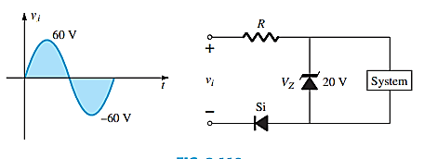
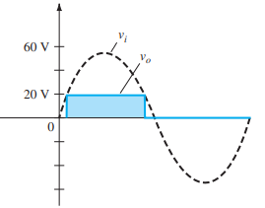
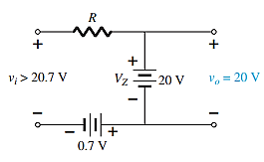
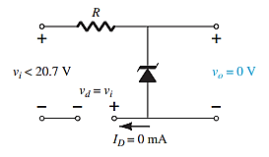
Zener Diodes
The network of the following figure is designed to limit the voltage to 20 V during the positive portion of the applied voltage and to 0 V for a negative excursion of the applied voltage. Check its operation and plot the waveform of the voltage across the system for the applied signal. Assume the system has a very high input resistance so it will not affect the behavior of the network
For positive cycle
For negative cycle

Slide 19
Zener Diode as Voltage Regulator
Three conditions are considered to analysis the Zener regulator circuit
V_{i} and R_{L} fixed
Fixed V_{i} and variable R_{L}
Variable V_{i} and R_{L} fixed

Slide 20
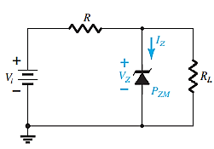
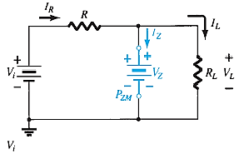
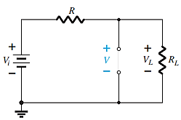






Voltage Regulator Circuit (V_{i} and R_{L} fixed:)
Step 1: To determine the state of the Zener diode, Apply Thevenin's theorem: remove Zener diode from the network
For Case-I: If V≥ V_{Z}, the Zener diode is on,
$$V_{L}=V_{z}$$
$$V=V_{L}=\frac{R_{L}V_{i}}{R+R_{L}}$$
$$I_{R}=I_{L}+I_{z}$$
$$I_{Z}=I_{R}−I_{L}$$
Case-I: If V≥ V_{Z}, the Zener diode is on,
Case-II: If V<V_{Z}, the diode is off,
$$I_{L}=\frac{V_{L}}{R_{L}}$$
$$I_{R}=\frac{V_{i}−V_{L}}{R}$$
The power dissipated by the Zener diode is
P_{Z} = V_{Z}I_{Z}

Slide 21
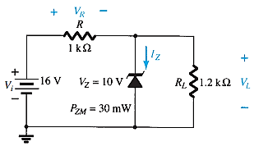
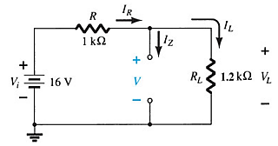
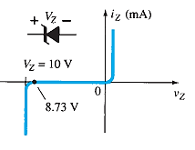




Example: a. For the following Zener diode network, determine V_{L} , V_{R} , I_{Z} , and P_{Z} b. Repeat part (a) with R_{L} = 3kΩ.
Step 1: Redraw the circuit by removing Zener diode from the network
Since V=8.73 V is less than V_{Z} =10V, the diode is off state as shown in the following characteristics curve.
$$V=V_{L}=\frac{R_{L}V_{i}}{R+R_{L}}=\frac{1.2kΩ×16V}{1kΩ+1.2kΩ}=8.73V$$
$$V=V_{L}=8.73V$$
$$V_{R}=V_{i}−V_{L}=16V−8.73V=7.27V$$
$$I_{Z}=0 A$$
$$P_{Z}=V_{Z}I_{Z}=0 W$$

Slide 22
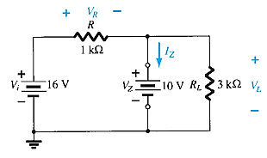




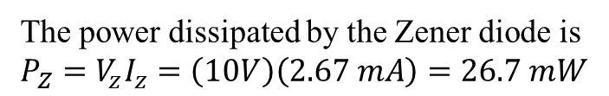

Example: b. Repeat part (a) with R_{L} = 3kΩ.
Step 1: Redraw the circuit by removing Zener diode from the network
$$V_{L}=V_{Z}=10V$$
$$V_{R}=V_{i}−V_{L}=16V−10V=6V$$
$$I_{L}=\frac{10V}{3kΩ}=3.33mA$$
$$I_{R}=\frac{6V}{1kΩ}=6mA$$
$$V=V_{L}=\frac{R_{L}V_{i}}{R+R_{L}}=\frac{3kΩ×16V}{1kΩ+3kΩ}=12V$$
$$I_{Z}=6mA−3.33mA=2.67mA$$
Since V =12 V is greater than V_{Z} =10V, the diode is in the “on” state.
The power dissipated by the Zener diode is $P_{Z}=V_{z}I_{z}=\left(10V\right)\left(2.67 mA\right)=26.7 mW$
P_{Z} that must be less than the P_{ZM} =30 mW specified for the device.

Slide 23


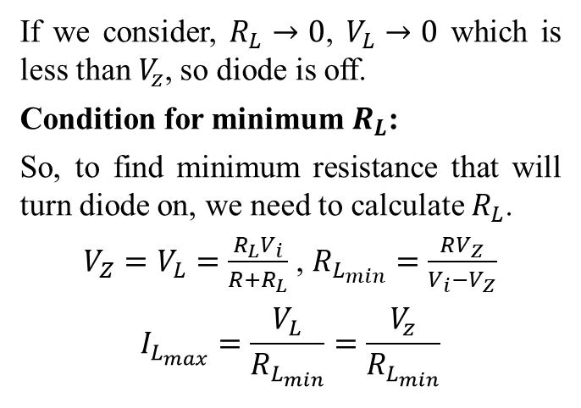
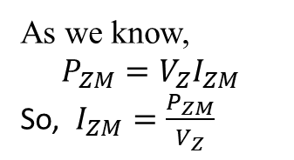
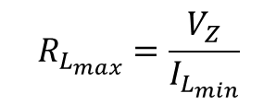



Voltage Regulator Circuit (V_{i} fixed & R_{L} variable:)
$$I_{R}=\frac{V_{i}−V_{Z}}{R}$$
Since, load is variable, we need to find minimum and maximum resistance, which remain the diode is on.
$$I_{Z_{min}}=I_{R}−I_{L_{max}}$$
Condition for maximum $R_{L}$:
How?
$$I_{L}=I_{R}−I_{z}$$
If we consider, $R_{L}→0$, $V_{L}→0$ which is less than $V_{z}$, so diode is off.
Condition for minimum $R_{L}$:
So, to find minimum resistance that will turn diode on, we need to calculate $R_{L}$.
$V_{Z}=V_{L}=\frac{R_{L}V_{i}}{R+R_{L}}$ , $R_{L_{min}}=\frac{RV_{Z}}{V_{i}−V_{Z}}$
$$I_{L_{max}}=\frac{V_{L}}{R_{L_{min}}}=\frac{V_{z}}{R_{L_{min}}}$$
$$I_{L_{min}}=I_{R}−I_{Z_{max}}$$
$$R_{L_{max}}=\frac{V_{Z}}{I_{L_{min}}}$$
As we know,
$$P_{ZM}=V_{Z}I_{ZM}$$
So, $I_{ZM}=\frac{P_{ZM}}{V_{Z}}$

Slide 24
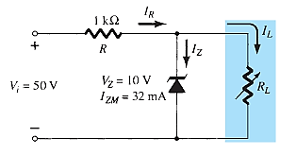




Example: For the following network:
determine the range of R_{L} and I_{L} that will result in V_{RL} being maintained at 10 V.
Determine the maximum wattage rating of the diode.
Condition for maximum $R_{L}$:
$$I_{R}=\frac{V_{i}−V_{Z}}{R}=\frac{50V−10V}{1kΩ}=40mA$$
$$I_{L}=I_{R}−I_{z}$$
$$I_{L_{min}}=40mA−32mA=8mA$$
$$R_{L_{max}}=\frac{10V}{8mA}=1.25kΩ$$
Solution:
To find minimum resistance that will turn diode on,
$$R_{L_{min}}=\frac{RV_{Z}}{V_{i}−V_{Z}}=\frac{1kΩ(10V)}{50V−10V}=0.25kΩ$$
$$I_{L_{max}}=\frac{V_{L}}{R_{L_{min}}}=\frac{10V}{0.25kΩ}=40mA$$
As we know,
$$P_{ZM}=V_{Z}I_{ZM}=10V\left(32mA\right)=320mW$$

Slide 25
Voltage Regulator Circuit (V_{i} variable & R_{L} Fixed:)
Homework

Slide 26


AC Regulator
Square Wave Generator

